Slide 1

Loan Repayment Assessment in Banking
- PRAKASH. P

Slide 2
Project Objectives and Goals
The primary objective of this project is to develop a robust predictive model capable of assessing loan repayment likelihood based on applicant information. By achieving this, we aim to support financial institutions in making more informed lending decisions, thereby reducing the risk of defaults and optimizing their loan portfolio management strategies.

Slide 3
Importance of Loan Repayment Prediction in Banking and Finance
Risk Management: Predicting loan repayment likelihood helps financial institutions assess the creditworthiness of applicants, thereby mitigating the risk of defaults and minimizing potential losses.
Portfolio Optimization: By accurately predicting loan repayment, banks can optimize their loan portfolios by identifying low-risk borrowers and offering them favorable loan terms.
Customer Satisfaction: Effective loan repayment prediction ensures that borrowers receive loans tailored to their financial capabilities, leading to higher customer satisfaction and loyalty.
Regulatory Compliance: Financial institutions are often subject to regulatory requirements related to lending practices. Implementing robust loan repayment prediction models helps ensure compliance with these regulations.

Slide 4
Exploratory Data Analysis (EDA)
Overview of the Dataset:
Features: Personal and financial information of loan applicants. Includes employment details, credit scores, loan amount, interest rate, etc.
Target Variable: Indicates whether the loan was paid or defaulted.
Key Insights: Diverse range of features influencing loan approval. Potential indicators of creditworthiness and repayment behavior.
Purpose: To build predictive models for assessing loan repayment likelihood.
Significance: Helps financial institutions make informed decisions and mitigate risks.
Conclusion: Valuable resource for understanding lending patterns and borrower behaviors.

Slide 5
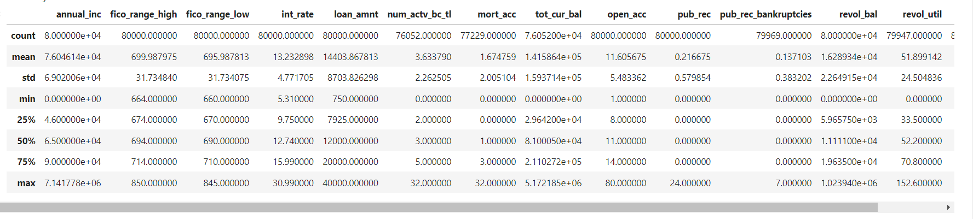
Exploratory Data Analysis (EDA)
Summary statistics of numerical features:

Slide 6
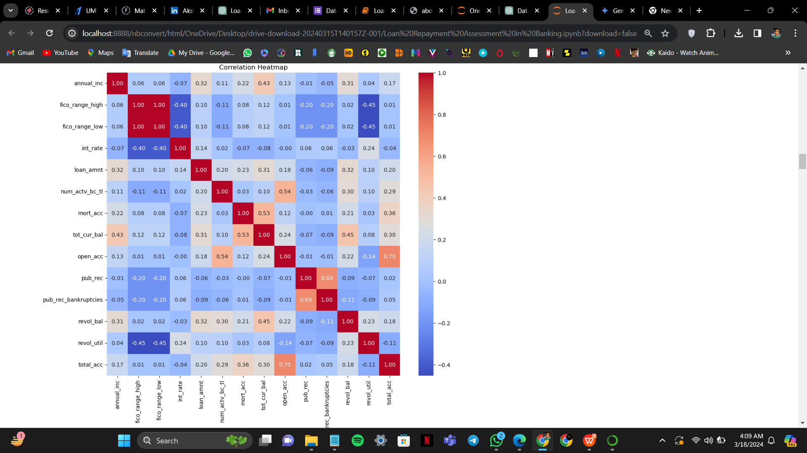
Exploratory Data Analysis (EDA)
Visualization of feature correlations

Slide 7
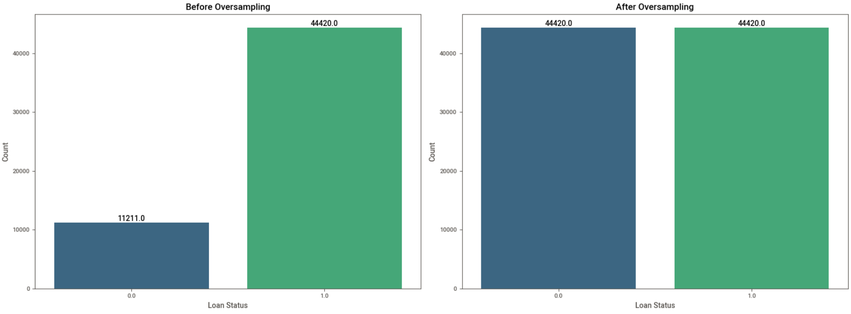
Exploratory Data Analysis (EDA)
Distribution of loan status (target variable)

Slide 8
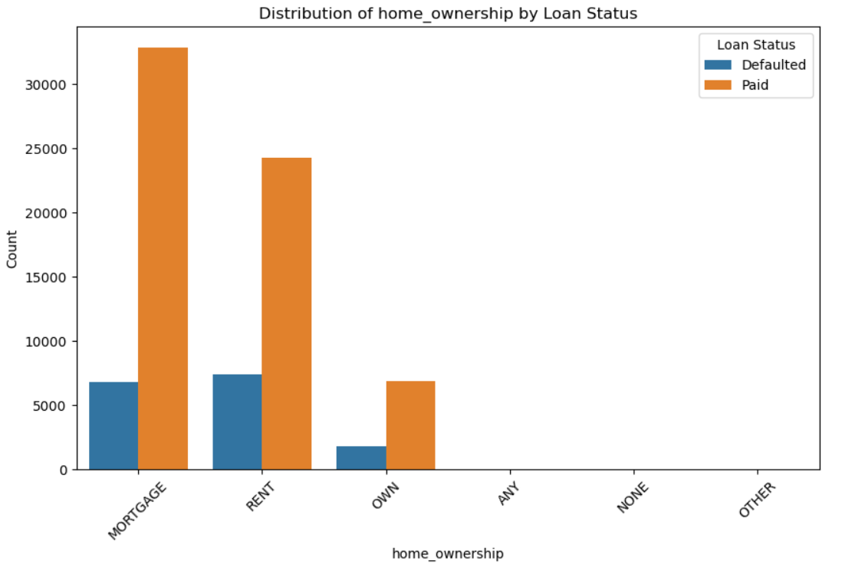
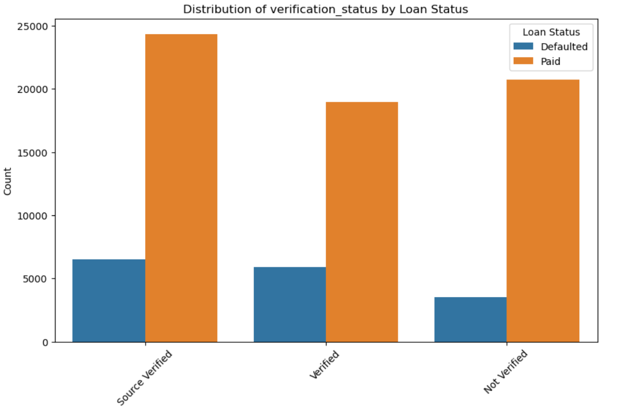
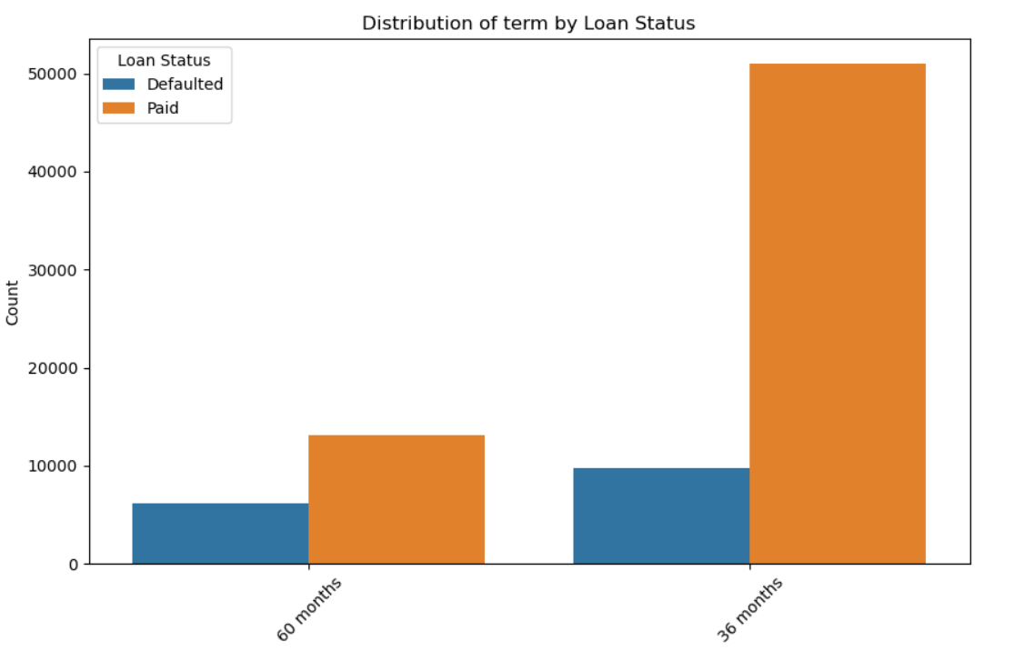
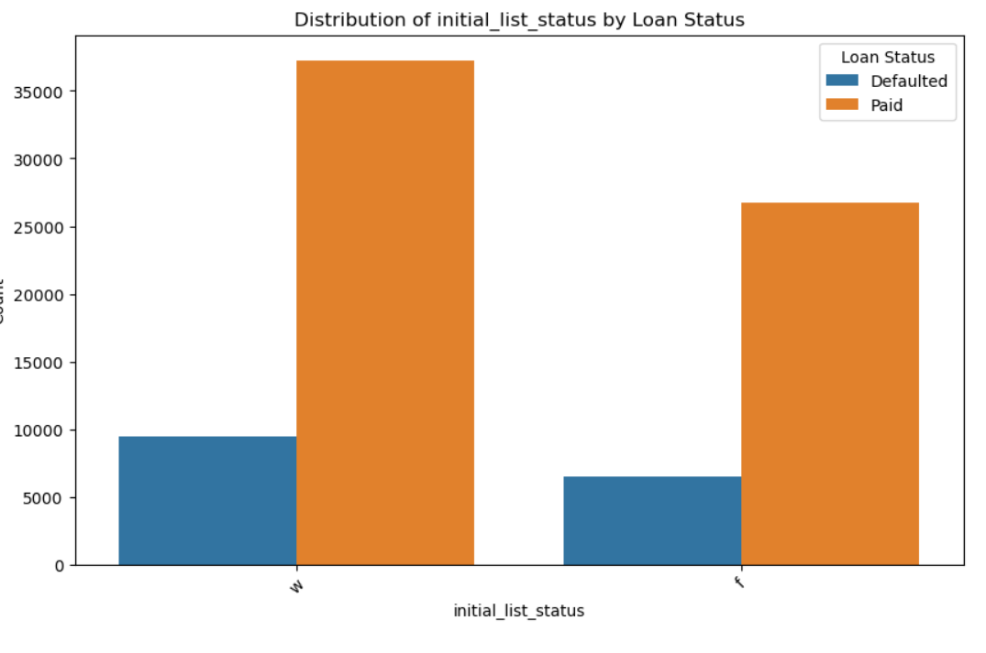
Exploratory Data Analysis (EDA)
Distribution of categorical features

Slide 9
Data Preprocessing
01
02
Handling missing values
Feature engineering
Machine learning
Data Preprocessing
03
04
Handling class imbalance
Feature selection

Slide 10
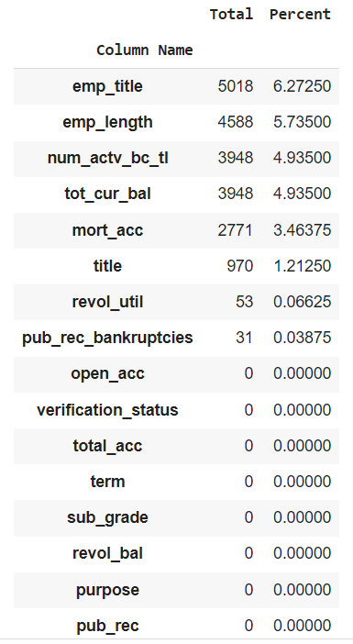
Data Preprocessing
Missing Values
Identified missing values in specific columns of both training and test datasets.
Employed various strategies for handling missing values:
Imputed missing values in 'emp_length' with the mode (most frequent value).
Filled missing values in 'emp_title' and 'title' with a new category 'Unknown'.
Imputed missing values in 'num_actv_bc_tl', 'mort_acc', 'tot_cur_bal', 'revol_util', and 'pub_rec_bankruptcies' with the median.
Ensured all missing values were properly addressed across the dataset.
Result:
No remaining missing values after handling.
Dataset is now ready for further analysis and modeling.

Slide 11
Data Preprocessing
Mapping Ordered Categorical Variables
Feature Engineering
01
Transformed categorical variables
Standardizing Numerical Features
02
using StandardScaler
Calculating Credit History Length
03
in years from 'earliest_cr_line' dates
One-Hot Encoding Categorical Features:
04
into binary representations

Slide 12

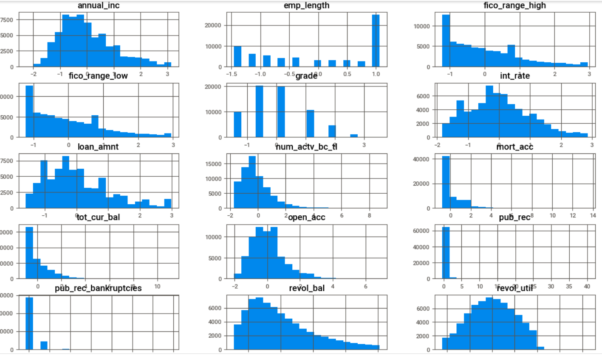
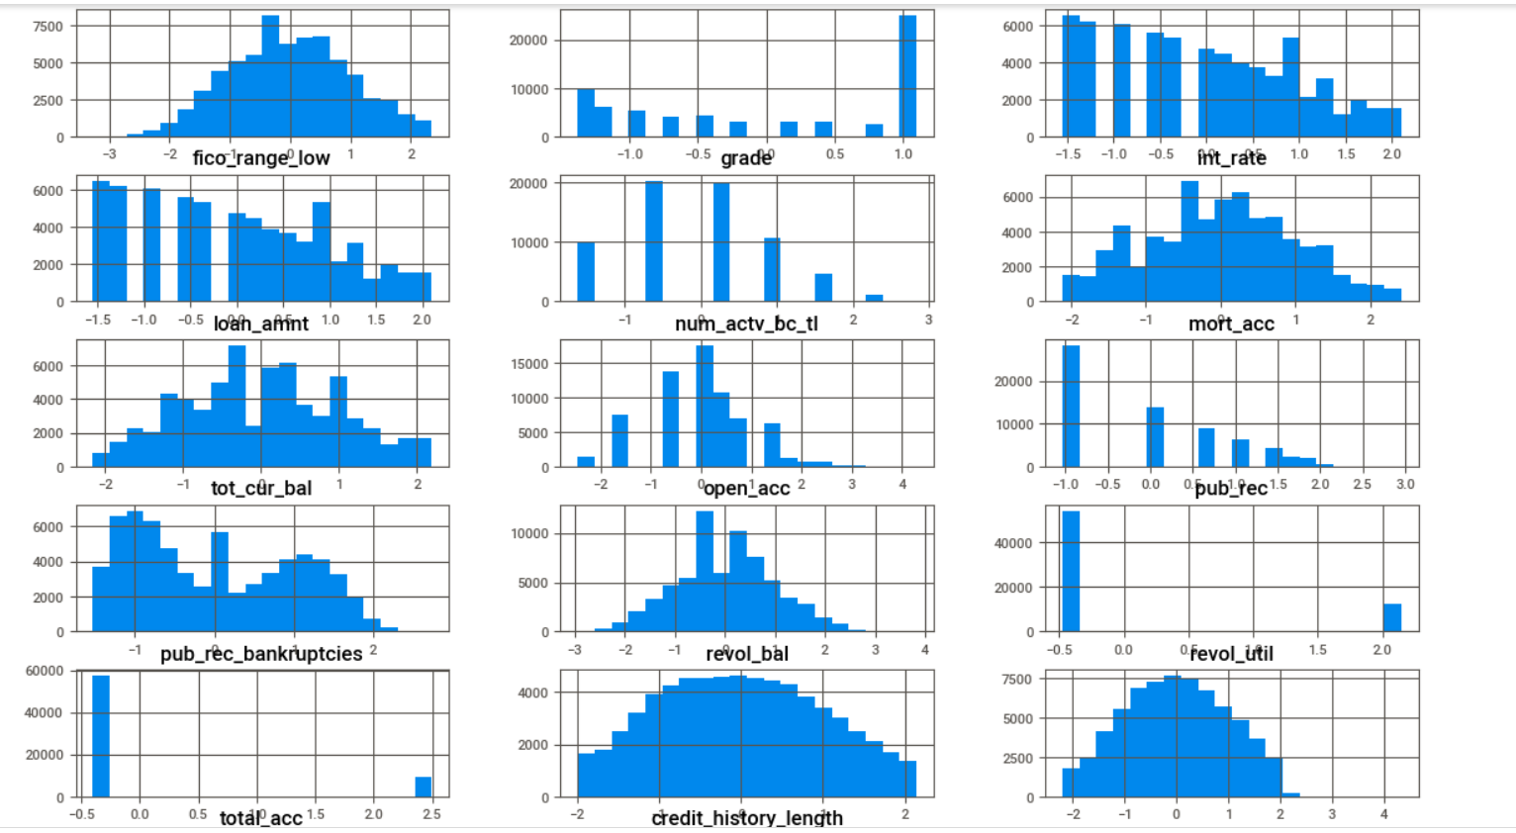

Slide 13
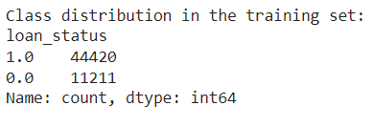
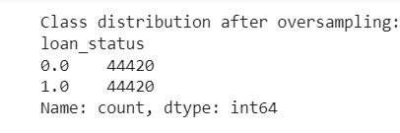
Data Preprocessing
Class Imbalance
Before Sampling
Approach: Used SMOTE to balance class distribution.
Implementation:
Applied SMOTE to oversample minority class.
Outcome:
Achieved balanced class distribution.
Rationale:
Impact of Imbalance: Biased predictions and reduced model effectiveness.
SMOTE Benefits: Generates synthetic samples for minority class, improving model learning.
Result: Enhanced model generalization and performance.
After Sampling

Slide 14
Data Preprocessing
Feature Selection
Approach: Used Random Forest Classifier for feature selection.
Implementation:
nitialized a Random Forest Classifier with 100 estimators.
Fit the classifier to the resampled training data.
Selected features based on importance weights from the classifier.
Outcome:
Identified the most important features for loan repayment prediction.
Result:
Selected Features:
'annual_inc', 'fico_range_high', 'fico_range_low', 'int_rate', 'loan_amnt', 'num_actv_bc_tl', 'mort_acc', 'tot_cur_bal', 'open_acc', 'revol_bal', 'revol_util', 'total_acc', 'grade_encoded', 'term_ 60 months'.

Slide 15
Modeling
Model Selection:
Choice: Selected Gradient Boosting Classifier.
Reasons:
Predictive Power: Known for high accuracy and robustness.
Handling Complexity: Effective for datasets with intricate patterns.
Reduced Overfitting: Implements techniques to mitigate overfitting, ensuring better generalization.
Robustness: Less sensitive to outliers compared to other models.
Interpretability: Provides insights into feature importance for understanding data relationships.
Outcome:
Chosen for its balance of predictive performance, robustness, and effectiveness in handling complex datasets.
This summary provides an overview of the decision to select the Gradient Boosting Classifier for loan repayment prediction, highlighting its strengths and suitability for the task at hand.

Slide 16
Modeling
Training the Model:
Initialization: Utilized Gradient Boosting Classifier with 100 estimators and random state 42.
Training Data: Trained on training dataset (X_train, y_train).
Objective: Adjusted model parameters to minimize loss function and enhance predictive performance.
Outcome: Model successfully trained on the dataset, ready for evaluation and prediction tasks.
This overview encapsulates the key steps involved in training the Gradient Boosting Classifier, emphasizing the model's initialization, training data usage, and the ultimate objective of achieving optimal predictive performance.

Slide 17
Modeling
Evaluation Metrics on Validation Dataset
Accuracy | 84.20%
Precision | 79.73%
Recall | 92.03%
F1-score: | 85.44%
Outcome: Model demonstrates strong performance in correctly identifying loan repayment statuses on the validation dataset.
This summary provides a concise overview of the model's performance evaluation on the validation dataset, highlighting key metrics that assess its effectiveness in predicting loan repayment status.

Slide 18
Modeling
Hyperparameter Tuning Using Grid Search:
Parameter Grid: Defined a parameter grid including n_estimators, learning_rate, and max_depth
Initialization: Initialized a Gradient Boosting Classifier with a random state of 42.
Grid Search Setup:
Utilized GridSearchCV to search for the best hyperparameters.
Utilized 5-fold cross-validation and accuracy scoring.
Best Hyperparameters:
Found the best hyperparameters: {'n_estimators': 150, 'learning_rate': 0.2, 'max_depth': 5}.
Achieved a cross-validation score of 0.869.
Outcome:
Identified optimal hyperparameters for the Gradient Boosting Classifier using grid search.
Ensured improved model performance by fine-tuning hyperparameters based on cross-validation results.

Slide 19
Model Evaluation
Model Evaluation with Best Hyperparameters
Initialization: Initialized a Gradient Boosting Classifier with the best hyperparameters.
Training: Trained the final model on the entire training dataset.
Prediction and Evaluation: Made predictions on the validation dataset and evaluated model performance using accuracy, precision, recall, and F1-score.
Decisions and Rationale:
Utilization of Grid Search: Leveraged grid search to exhaustively search for optimal hyperparameters, enhancing model performance.
Cross-Validation: Employed cross-validation to ensure generalization and robustness of model hyperparameters.
Final Model Training: Utilized the entire training dataset to train the final model, maximizing available data for learning.
Performance Evaluation: Assessed model performance using multiple metrics to provide a comprehensive understanding of its predictive capabilities.
This summary encapsulates the process of hyperparameter tuning using grid search, detailing the search for optimal hyperparameters and subsequent evaluation of model performance using the selected parameters.

Slide 20
Testing model on test dataset
Training the Final Model on the Test Dataset
Model Training
Predictions on Test Dataset
Evaluation
Trained the final Gradient Boosting classifier model (best_gb_classifier) on the training dataset (X_train, y_train).
Utilized the trained model to make predictions on the test dataset (X_test_selected).
Predictions on the test dataset will be used to evaluate the model's performance on completely new data, assessing its generalization capability.
Decision
Decision
Trained the final model on the training dataset to learn patterns and relationships in the data.
Applied the trained model to the test dataset to generate predictions on unseen data.

Slide 21
Testing model on test dataset
Predicted Loan Status for Test Data
Data Processing:
Created a DataFrame predicted_data to store predicted loan status labels (y_pred_test) generated by the final model.
Mapped predicted labels to their corresponding categories using a dictionary: 0 -> 'Defaulted', 1 -> 'Paid'.
Merging DataFrames: Combined the original test DataFrame (test_df) with the predicted loan status DataFrame (predicted_data) to create predicted_test_loan_data.
Output: Displayed the merged DataFrame predicted_test_loan_data, containing original test data and predicted loan status labels.
Decisions and Rationale:
Categorical Mapping: Converted numerical predictions to categorical labels for clarity and ease of interpretation.
Data Comparison: Merged original test data with predicted loan statuses to facilitate comparison and evaluation of model predictions against actual loan statuses.
Evaluation: Provides insights into the model's performance in predicting loan statuses on unseen data, aiding in the assessment of model effectiveness.

Slide 22
Export Predicted Loan Status Data
Action Taken
Utilized the to_csv() function to save the DataFrame predicted_test_loan_data into a CSV file named 'predicted_test_loan_data.csv'.
Excluded the DataFrame index from the CSV file using the parameter index=False.
Predicted Loan Status Data
Decisions and Rationale
Data Preservation: Saving the predicted loan status data facilitates additional analysis or sharing with stakeholders.
File Cleanliness: Excluding the index column maintains the CSV file's clarity and conciseness, particularly if the index lacks meaningful information for interpretation.

Slide 23
Summary
Model Performance
Model Applicability
Gradient Boosting model achieves impressive accuracy, precision, recall, and F1-score, indicating its effectiveness in predicting loan repayment outcomes.
Model is well-suited for real-world banking applications, offering reliable insights to aid in risk assessment and decision-making processes.
Areas for Improvement
While precision is relatively high, reducing false positive predictions could enhance the model's performance further.
Strengths
Conclusion
The model demonstrates high recall, essential for identifying loans likely to be repaid, and maintains a good balance between precision and recall, making it suitable for banking applications.
The Gradient Boosting model presents a powerful tool for financial institutions, contributing to prudent lending practices and minimizing financial risks associated with loan defaults.

Slide 24
Thank you

